Slide 1
Nova AI Ecosystem: Dual-AI Solutions Suite
Team Nova (Team 013)

Slide 2
Nova AI Ecosystem: Dual-AI Solutions Suite
Unit 1. Introduction
1.1. Motivation & Problem Statement
1.2. Objectives & Solution Overview
1.3. Team Roles
Unit 2. Project Execution
2.1. System Architecture (Headless Microservices)
2.2. Workflow A: Intelligent Resume Screener
2.3. Workflow B: AI Research Agent (RAG)
Unit 3. Results & Impact
3.1. Key Results & Performance Metrics
3.2. Live Demo & User Interface
3.3. Future Scope

Slide 3


The Unstructured Data Bottleneck
1.1
Motivation & Problem Statement
UNIT
01
Recruitment Bottlenecks:
HR teams are overwhelmed by volume. Manual screening causes bias and slow "Time-to-Hire."Level-1
Research Inefficiency:
Researchers struggle to find specific answers in dense technical PDFs using standard keyword search (Ctrl+F).
The Need:
A unified, automated system to handle unstructured text data (Resumes & Research Papers) efficiently.

Slide 4
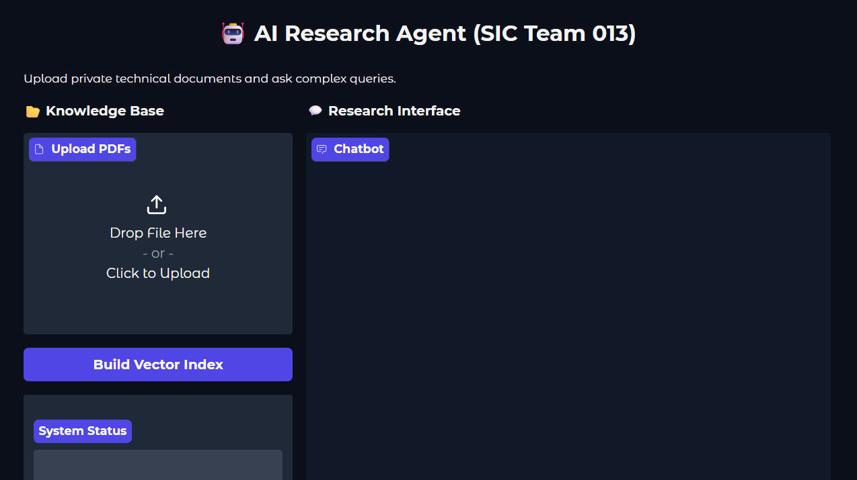
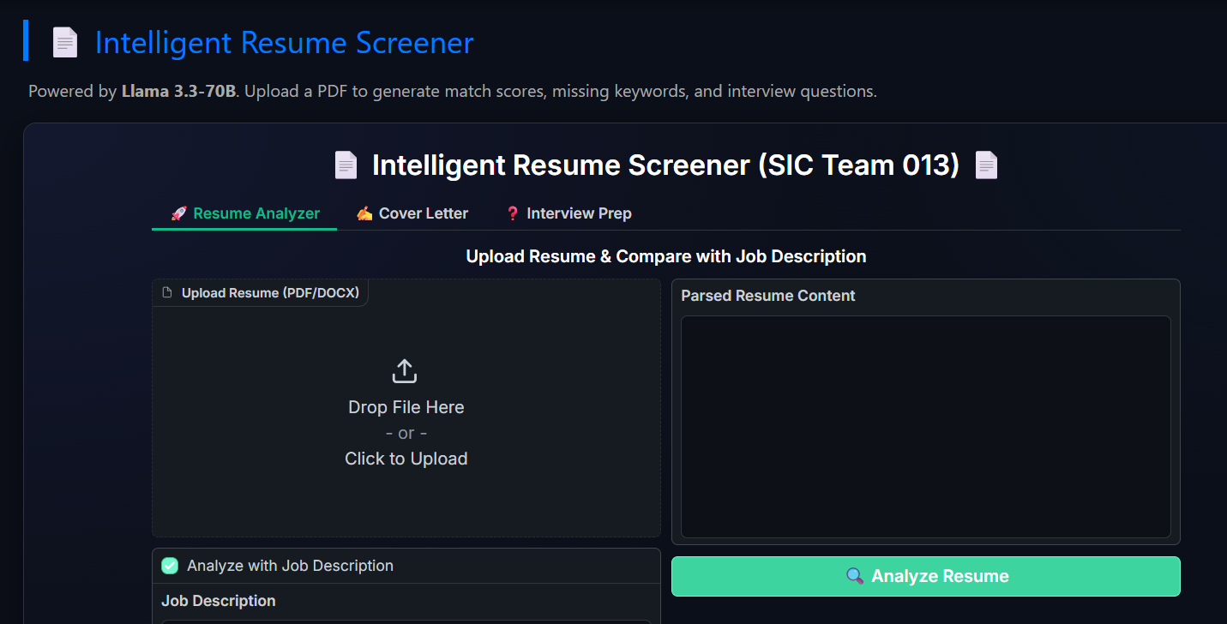
Solution - Nova AI Ecosystem
1.2
Objectives & Solution Overview
UNIT
01
Objective: To demonstrate a "Headless Microservices" architecture for scalable AI deployment.
Nova AI Ecosystem:
Resume Screener: Acts as a "Strict ATS" using Llama 3 to score candidates and draft cover letters.
Research Agent: Uses RAG (Retrieval-Augmented Generation) to answer queries from technical papers.

Slide 5
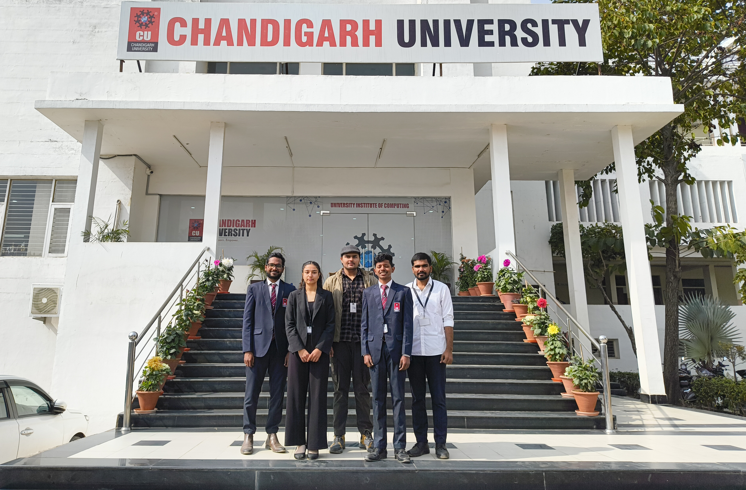
1.3
Team Roles
UNIT
01
Vasamsetti Naga Bala (Swamy) – Team Leader
Kovvuri PC Durga Reddy – Model Builder
Devesh Panwar – Presentation
Sakshi – Research & Testing
Dhadi Eswar – Data Lead

Slide 6
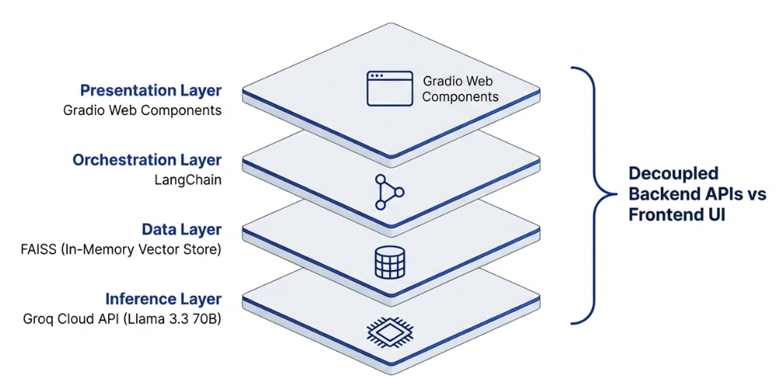
The Headless Approach
2.1
System Architecture (Headless Microservices)
UNIT
02

Slide 7
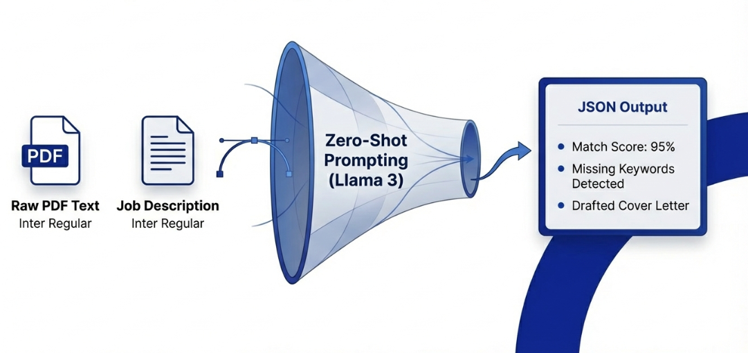
2.2
Workflow A: Intelligent Resume Screener
UNIT
02
Input: Raw PDF Text + Job Description.
Methodology: Zero-Shot Prompting.
Process: The model acts as an objective evaluator, extracting hard skills and comparing them to the JD.
Output: JSON structure with Match Score (0-100%), Missing Keywords, and Drafted Cover Letter.

Slide 8
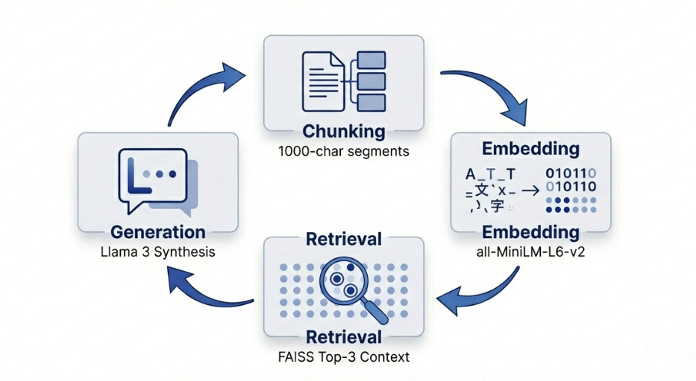
2.3
Workflow B: AI Research Agent (RAG)
UNIT
02
Chunking: Documents split into 1000-character chunks (200 overlap).
Embedding: all-MiniLM-L6-v2 model converts text to vectors.
Retrieval: FAISS retrieves the top 3 most relevant chunks based on user query.
Generation: Llama 3 synthesizes the final answer using the retrieved context.

Slide 9
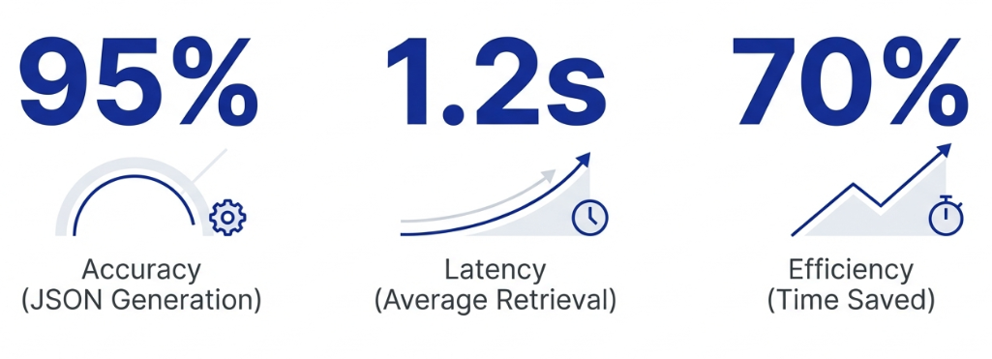
3.1
Key Results & Performance Metrics
UNIT
03
Accuracy: 95% success rate in generating valid JSON outputs for resumes.
Speed: Average retrieval time of 1.2 seconds for the RAG agent.
Efficiency: Automated screening reduces manual review time by ~70%.
Validation: Successfully tested on diverse datasets (Google/Uber resumes & arXiv papers).

Slide 10
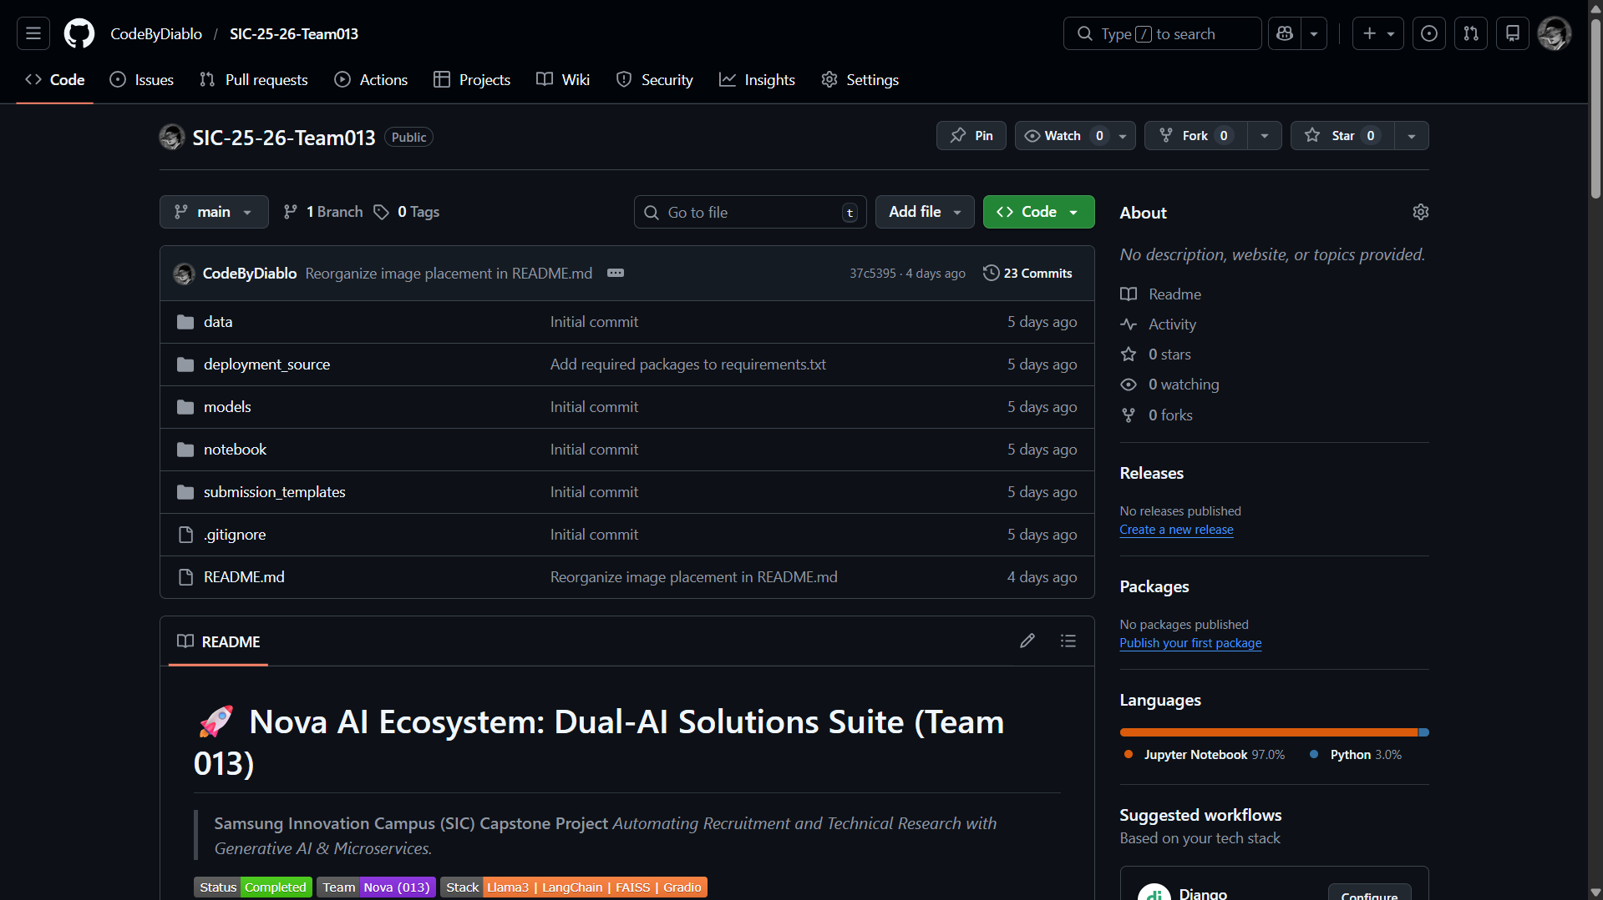
3.2
Live Demo & User Interface
UNIT
03
Unified Dashboard: Hosted on Vercel (sic-team013-frontend.vercel.app).
Features: Drag-and-drop PDF upload, Real-time Chat Interface, Visual Match Score display.

Slide 11
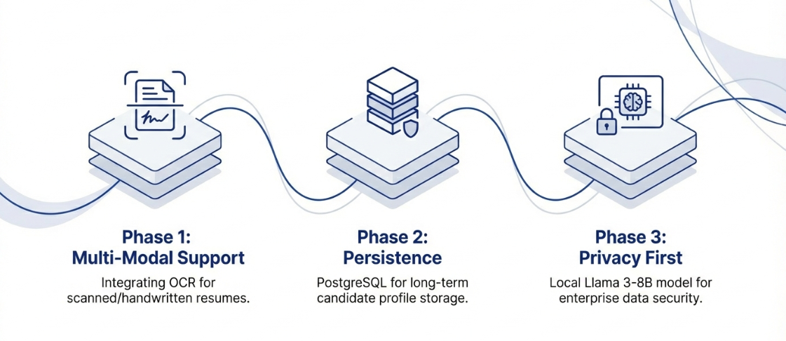
3.3
Future Scope
UNIT
03
Multi-Modal Support: Integrating OCR for scanned/handwritten resumes.
Database: Adding PostgreSQL for long-term candidate profile storage.
Fine-Tuning: Training a smaller Llama 3-8B model locally for privacy-first enterprise deployment.

